Slide 1
Piano Training Simulator
Group 31: Ryan, Edward, Abel, Beyza

Slide 2
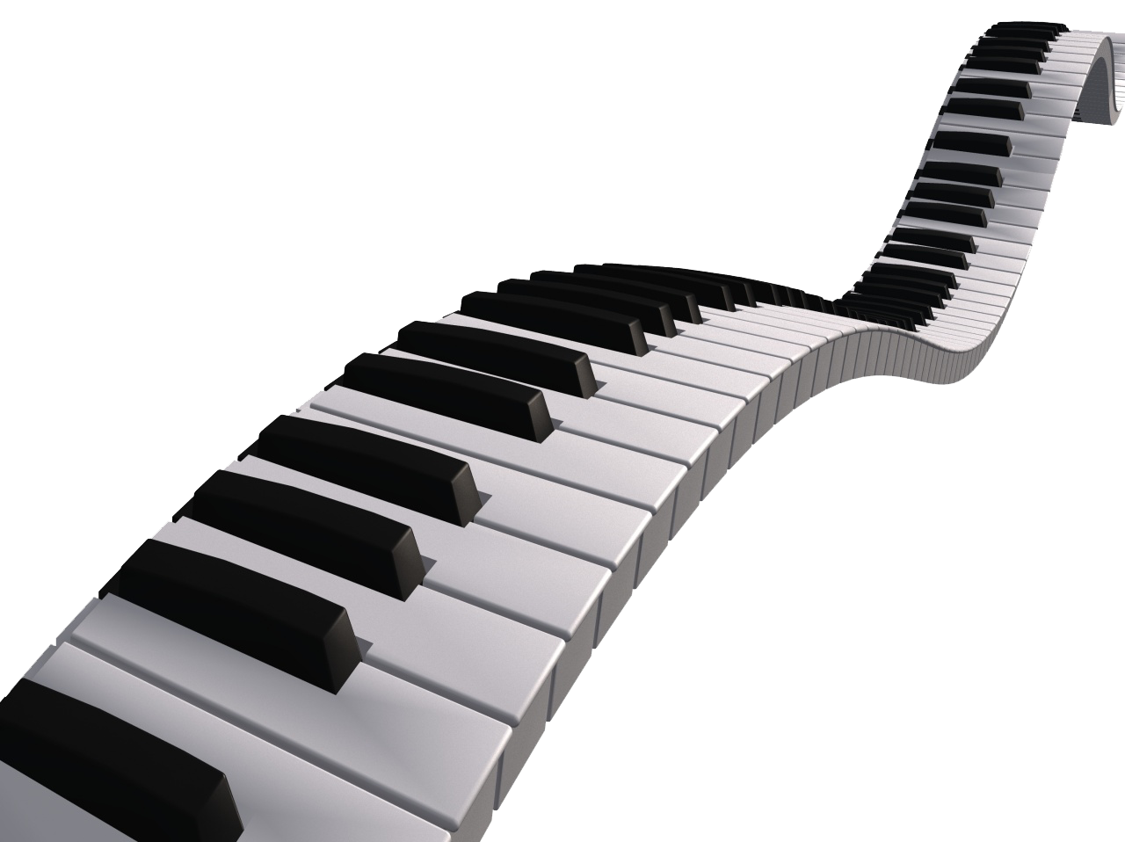

What is the Piano Training Simulator?
User-friendly, AIO desktop application for piano playing with robust, built-in features.
Software and hardware combination (external midi keyboard not included) will allow for the user to accomplish their desired goals with the simulator.
Many different situational uses, which include but are not limited to:
Learning how to play the piano
Getting better at playing a specific song
Beating other local users high scores
Beating your personal best score
Features included that help solidify usage scenarios.

Slide 3
Goals and Features
Intuitive UI
Record Performances
Ease of Song Selection
Fully Fledged yet Portable
AI Performance Analysis

Slide 4

IT’S DEMO TIME

